Slide 1

Basic Details of the Team and Problem Statement
Ministry/Organization Name/Student Innovation: Dairy Division Of Department Of Animal Husbandry And Dairying, Ministry Of Fisheries, Animal Husbandry And Dairying
PS Code: DV1080
Problem Statement Title: Online registration and processing of dairy farmers producing milk and other livestock products
Team Name: Treenity
Team Leader Name: Mohit Vyas
Institute Code (AISHE): U-0378
Institute Name: Indian Institute of Technology, Ropar
Theme Name: Agriculture, FoodTech & Rural Development

Slide 2
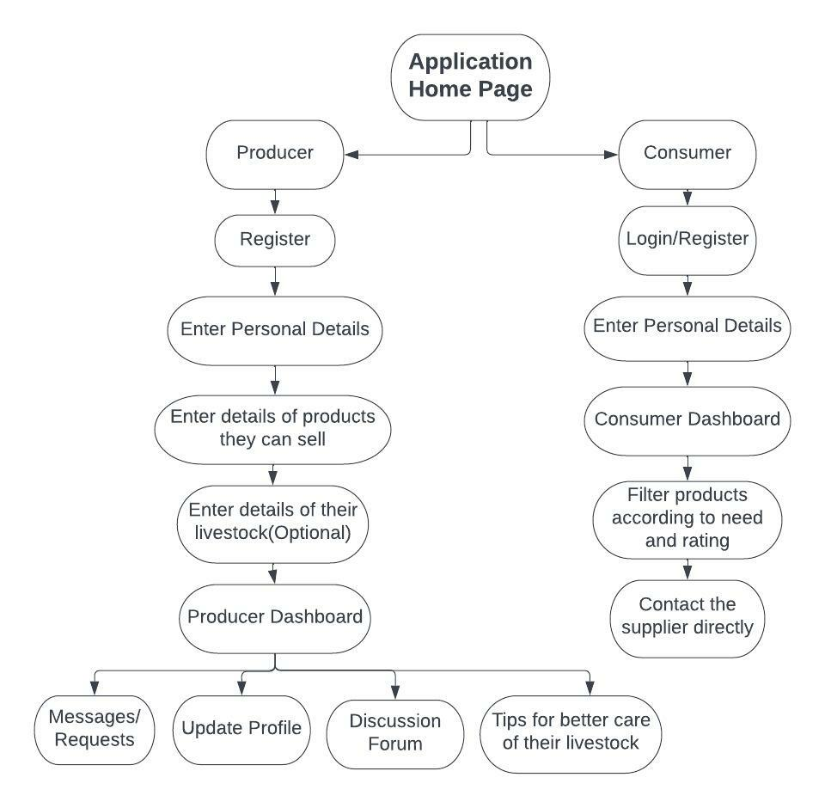
Idea/Approach Details
Our idea/Solution/Prototype:
We will develop an app that will provide a one stop solution where farmers can sell their dairy and poultry products easily. Such an app will help them provide market linkage.
The app will provide a registration page to the consumers and dairy and poultry producers.
The app will be available in different languages to increase the target users.
Producers and consumers can register by entering their username, password, e-mail id, phone number and address.
Both producers and consumers will have to verify by their identity by entering their AADHAR number for security purposes in case of conflicts in future.
Producers will then enter the quantity and type of products they can provide, distance up to which they can supply to etc.
Consumers will have a option to rate the farm according to the quality of the products.
Consumers can filter the suppliers according to various parameters like the amount of products they need, rating of the supplier, distance of the supplier from their location..
Our app will also educate the farmers about the maintenance and health of their livestock by providing them useful suggestions and tips which will help them increase their production.
Our app will also provide a discussion forum for the producers where they can discuss their problems among themselves or share some helpful tips with other producers.
** For detailed description of our idea, please read the ‘other document’ submitted by us.
Technology stack:
MOBILE APPLICATION:
Front-end : XML
Backend: Kotlin
DATABASE: Google Firebase and Firestore
VERSIONS CONTROL SYSTEM: GIT
IDE: Android Studio

Slide 3
Idea/Approach Details
Describe your Dependencies / Show stopper here
Use Cases of our App:
Authenticity of sellers and buyers
Lack of android users in backward areas.
Our app will be used by:
Dairy and Poultry farmers:
Small scale producers: Any small scale producers like marginal and women farmers who don’t have enough connectivity to the market will register on our app. This will provide them market linkage.
Large scale producers: Any large scale producers having extra produce will register and sell their products easily on our app.
Small scale buyers: Any household that requires these products can visit our app can search for the best options available to them.
Large scale buyers: Any existing or new cooperatives coming up that require these products in large quantities can visit our app can search for the potential suppliers. If anyone is organizing an event or a function and require these products in a large quantity can visit our app.
*Any new cooperatives that want to set up their plant can find the locations that will be best for them, by checking on our app places where they can get the best supply of raw products.
*Anyone who wants to learn about care and maintenance of livestock can visit our app.
Additional clinical features of our app
**The data collected by our app can be used to find locations where milk is produced in excess and a medium can be developed to supply this milk in the areas where the production is less. This will ensure equilibrium in prices at both these locations and the extra production will not go to waste.
** The data can also be used by government to help marginal and women farmers who have registered on our app but are still are not able to sell their produce.
**Our app we will also collect the count of the livestock in a particular area. This will act as a census for the livestock and will be helpful to provide some special benefits in certain areas.
** The data collected from the discussion forum will also be beneficial as it will provide information about the current situation/problems of farmers/producers.

Slide 4
Team Member Details
Team Leader Name: Mohit Vyas
Branch: B.Tech Stream : EE Year (I,II,III,IV): II
Team Member 1 Name: Aditya Bal Gupta
Branch: B.Tech Stream : CSE Year (I,II,III,IV): II
Team Member 2 Name: Jemee Butani
Branch: B.Tech Stream : CSE Year (I,II,III,IV): II
Team Member 3 Name: Piyush Kushwaha
Branch: B.Tech Stream : ME Year (I,II,III,IV): II
Team Member 4 Name: Ranjeet Bahadur
Branch: B.Tech Stream : ME Year (I,II,III,IV): II
Team Member 5 Name: Komal Meena
Branch: B.Tech Stream : ME Year (I,II,III,IV): II

